Slide 1
Mathematical Presentation of Data

Slide 2
Measures of Central Tendency
These are the heart of any distribution and include
the mean,
median and
mode.
Each of these measures may be calculated from raw data or from tabulated data

Slide 3
Sample Mean
The arithmetic mean (or, simply, mean) is a measure of location of the group.
It is a single number which enables us to assess the position in which the group is located with respect to other groups

Slide 4
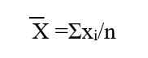
The mean is computed by summing all the observations in the sample and dividing the sum by the number of observations.

Slide 5
Sample Median
&
In a list ranked from smallest measurement to the highest, the median is the middle value.
For odd numbers: Rank of median =
For even numbers: Rank of median = &

Slide 6
Sample mode
The mode is the most commonly observed value of a variable, i.e., the value which occurs with the greatest frequency

Slide 7
Properties of measures of central tendency
Mean is sensitive to the tails (outlying observation), median and mode not.
Mode can be affected by little changes in the data, median and mean, not.
Mode and median can be found in a chart.
The three measures are the same in a Normal Distribution

Slide 8
Which measurement to use?
For skewed distributions, we use median.
For statistical analysis or inference, we use mean

Slide 9
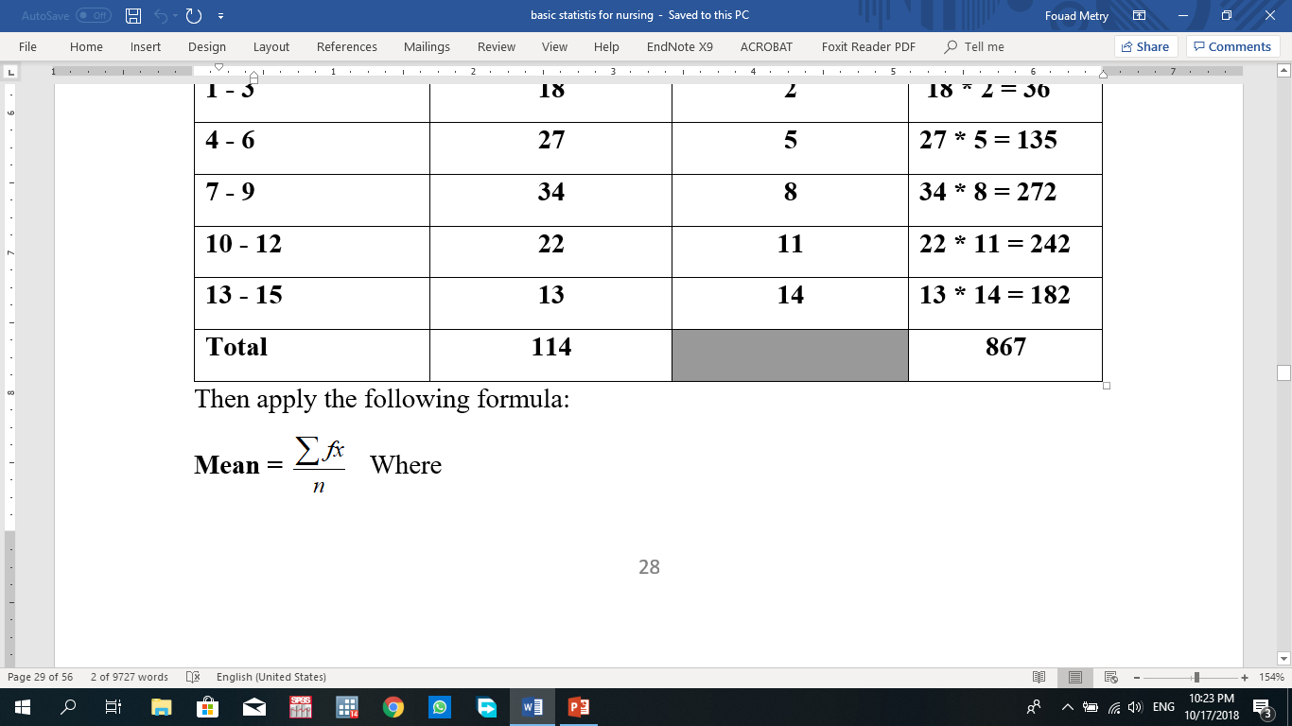
Calculating measures of central tendency from grouped data:
Mean

Slide 10
Category | Frequency (f_{i}) | Interval Midpoint (x_{i}) | f_{i} * x_{i}
1 - 3 | 18 | 2 | 18 * 2 = 36
4 - 6 | 27 | 5 | 27 * 5 = 135
7 - 9 | 34 | 8 | 34 * 8 = 272
10 - 12 | 22 | 11 | 22 * 11 = 242
13 - 15 | 13 | 14 | 13 * 14 = 182
Total | 114 |  | 867

Slide 11
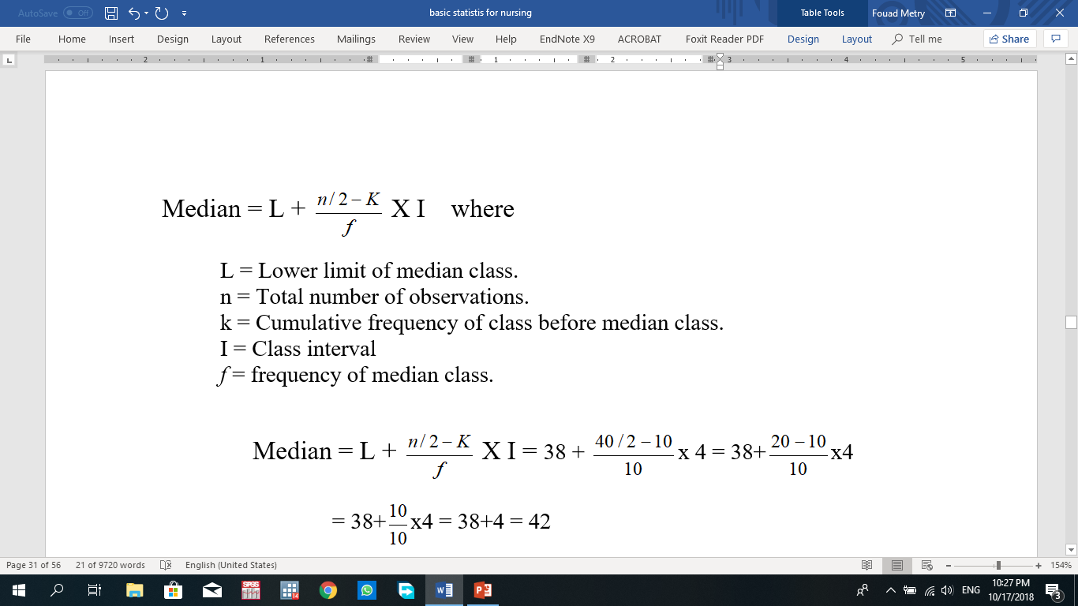
Median

Slide 12
Category | Frequency | Cumulative frequency
30- 34- 38- 42- 46-50 | 4 6 10 12 8 | 4 10 20 32 40
Total | 40

Slide 13
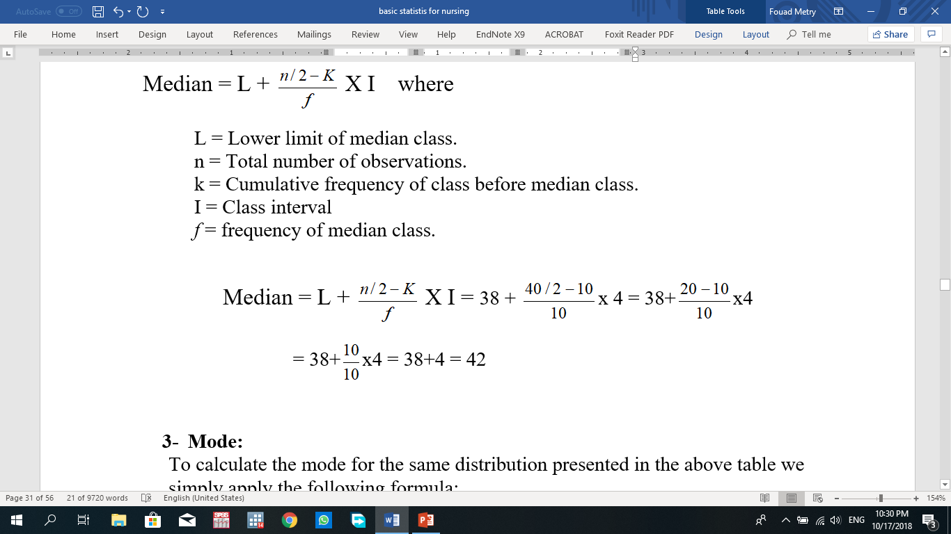

Slide 14
Mode
To calculate the mode for the same distribution presented in the above table we simply apply the following formula

Slide 15
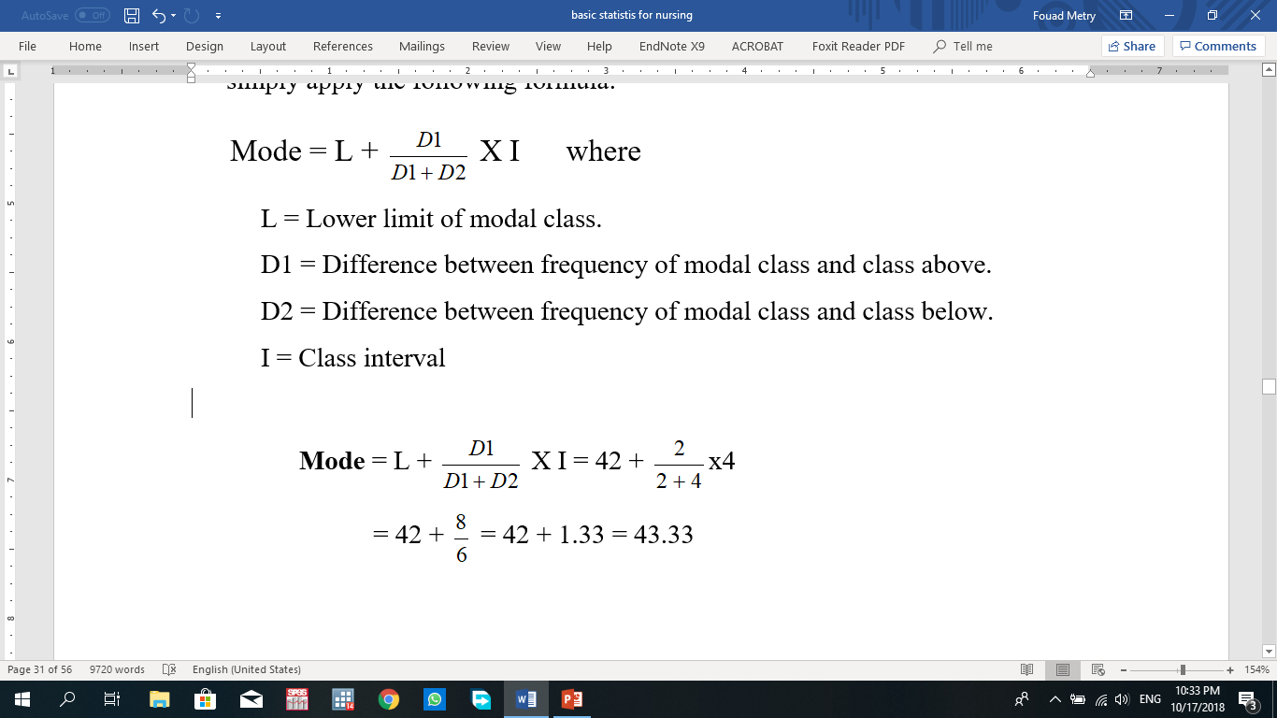

Slide 17
Thank you

